Slide 1
Fanex.Data.Repository
R&D Team - Edward.Nguyen

Slide 2
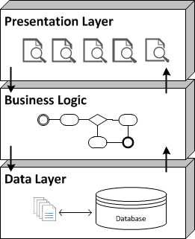

Three layered
Business Layer

Slide 3
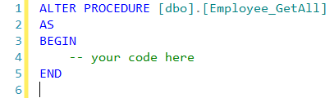
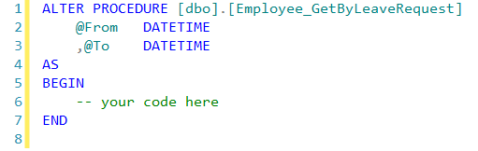
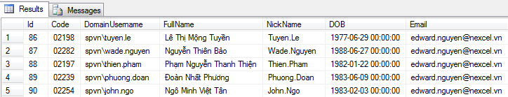
With stored procedure

Slide 4
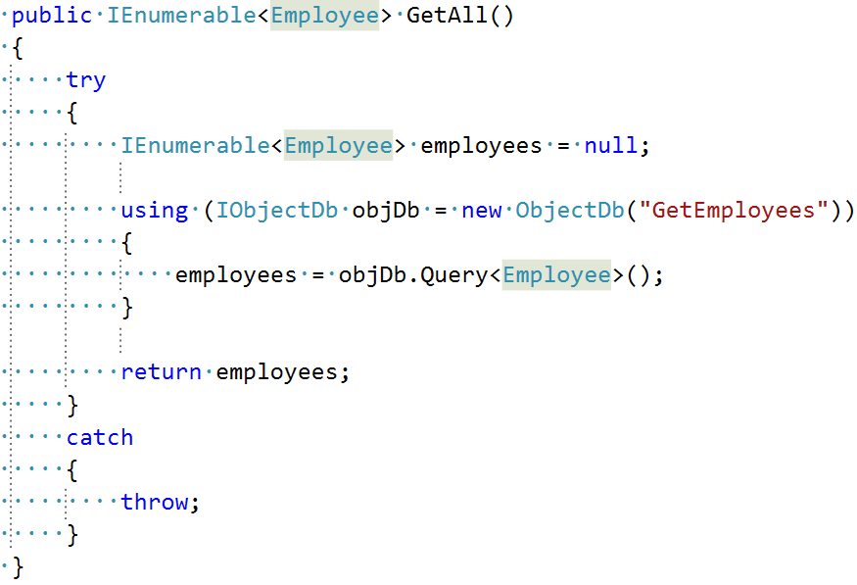
EmployeeRepository class

Slide 5
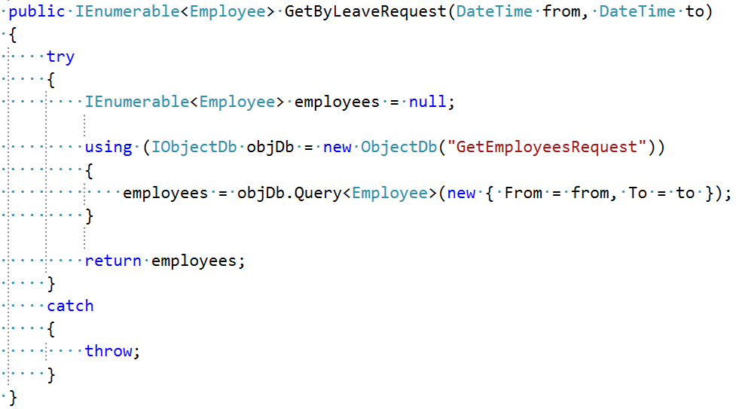

EmployeeRepository class
2 functions look like the same ?

Slide 6
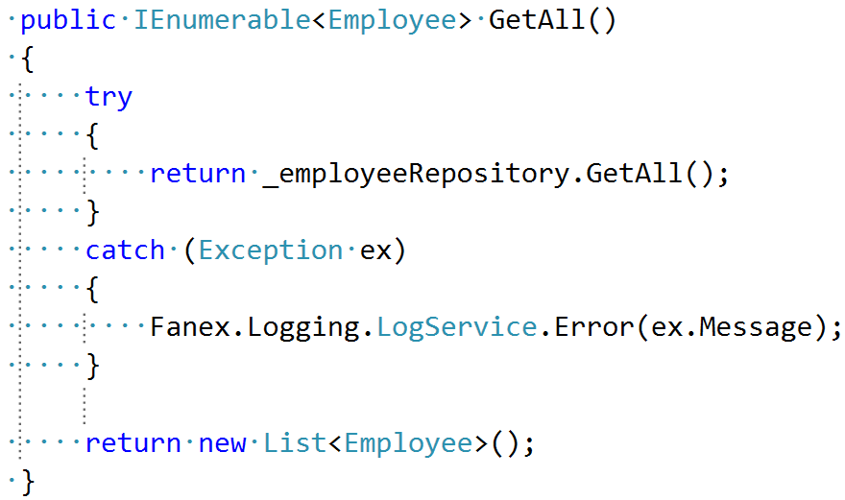
EmployeeService class

Slide 7
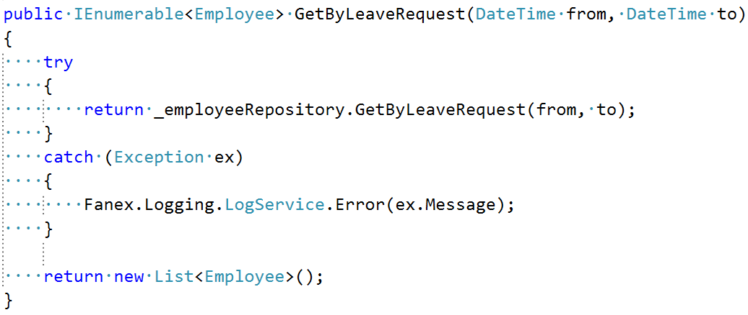

EmployeeService class
How about if we have a new business request ?
one function in service -> one function in data access layer

Slide 8


Is there a simple way to solve ... ?
duplication
Fanex.Data.Repository
more code -> more bugs
take time

Slide 9
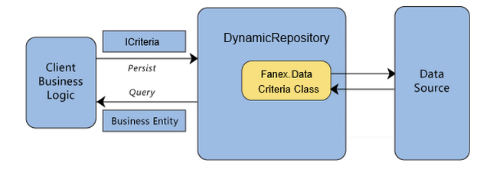
What is Fanex.Data.Repository ?
Repository Pattern : a mediates between the domain and mapping layers using a collection-like interface for accessing domain objects.
Criteria class

Slide 10
Why using Fanex.Data.Repository
Develop faster
Avoiding duplicate data access code
Improve the code’s maintainability and readability
Less code -> less bugs -> get more

Slide 11
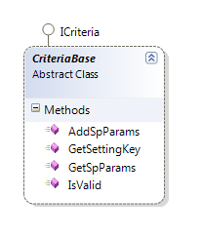

Criteria class
Implement base on design point Repository Pattern
A criteria object specifying the characteristics of the objects they want returned from a query

Slide 12
Criteria class description
 | Name | Description
 | GetSettingKey | Hard code return setting key
 | GetSpParams | Return HashTable
 | IsValid | Implement check business logic

Slide 13
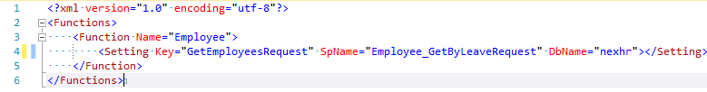
Criteria class example
The setting key

Slide 14
Criteria class example
The stored procedure

Slide 15
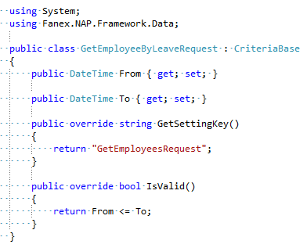
Criteria class example
property is parameter
check logic code

Slide 16
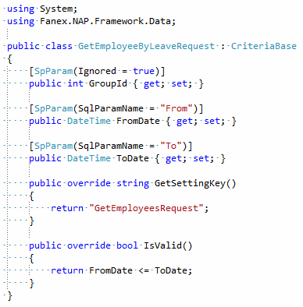
Attribute of criteria class
Ignore property is not parameter
Rename parameter name

Slide 17
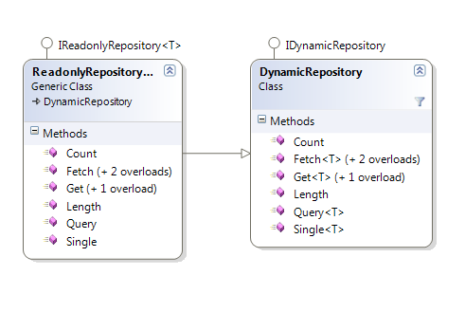
Drill down Fanex.Data.Repository core

Slide 18
DynamicRepository description
 | Name | Description
 | Get(Int32) | Return and object type T. This method is not implement so you must to override and implement your code
 | Get(ICriteria) | Return and object type T
 | Count(ICriteria) | Return the first column of the first row in the result set, or value is 0 if a null reference
 | Fetch | Returns an IEnumerable<T>. This method is not implement so you must to override and implement your code
 | Fetch(ICriteria) | Returns an IEnumerable<T>
 | Fetch(ICriteria,Action<Orderable>) | Returns an IEnumerable<T>

Slide 19

DynamicRepository description
 | Name | Description
 | Single(dynamic) | Return and object type T
 | Query(dynamic) | Returns an IEnumerable<T>
 | Length(dynamic) | Return the first column of the first row in the result set, or value is 0 if a null reference
dynamic criteria

Slide 20
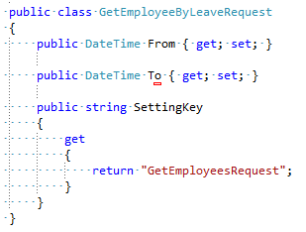
Dynamic criteria class
The class must be have property SettingKey

Slide 21
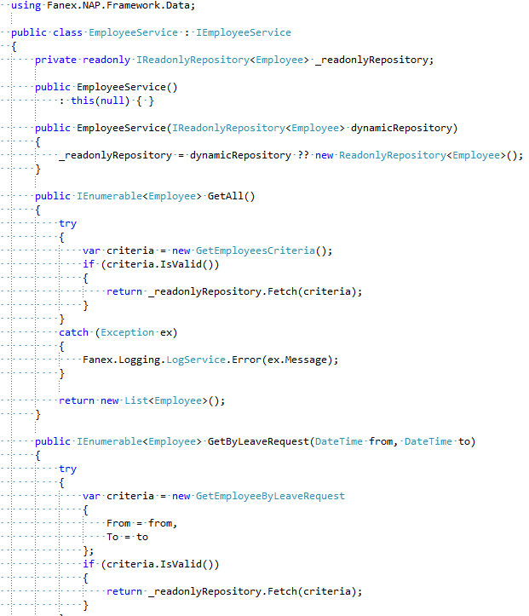

Slide 22
no more EmployeeRepository

Slide 23

Demo time
Implement Fanex.Data.Repository

Slide 24


